Slide 1
Intro to OneDrive Next Gen Sync
What is it, How Does it Work, and Can I Manage it?

Slide 2
Paul Papanek Stork
Owner/Principal Architect
Don’t Pa..Panic Consulting
Author
Developer’s Guide to WSS 3.0
MOSS 2007 Best Practices
MCTS: WSS 3.0 Configuration Study Guide (70-631)
SharePoint 2010 Development for Office 365
Microsoft Community Contributor
Technet Forums
MSDN Forums
Yammer Groups
Contact Information
Email: pstork@att.net
Blog: http://dontPaPanic.com/blog
Twitter: @PStork
Notes:
Principal SharePoint Architect for BlueChip Consulting Group
http://www.bluechip-llc.com
SharePoint MVP for 11 years
SharePoint Microsoft Certified Master
Author
Developer’s Guide to WSS 3.0
MOSS 2007 Best Practices
MCTS: WSS 3.0 Configuration Study Guide (70-631)
SharePoint 2010 Development for Office 365
Contact Information
Email: Paul.Stork@bluechip-llc.com
Blog: http://dontPaPanic.com/blog
Twitter: @PStork

Slide 3
Agenda
Why Use OneDrive Sync?
What Can I Sync with OneDrive?
How Do I Administer it?
For Myself
As an Enterprise Administrator

Slide 4
Why Use OneDrive?
Share and work together on all your files
Access files from all your devices
Share inside or outside
your organization
Collaborate with deep Office integration
Quickly find files
that matter most

Slide 5
Recent Improvements
Secure external anonymous sharing | Service level encryption with customer key
Mac Office sync client integration | File preview support on mobile
Files On-Demand | Real time co-authoring in iOS
Shared by me | Known Folder Move (KFM)
Support for onedrive.exe and Files On-Demand for SharePoint 2019 | Unified share experience across Office, Mac, PC, web, and mobile
Files Restore | Multi-Geo support

Slide 6
What Can the Next Gen Client Do?
Sync Selected OneDrive Consumer Folders
Sync Selected OneDrive for Business Folders
Sync SharePoint Online Libraries and Folders
Sync SharePoint 2019 On-Premises Libraries and Folders
Extends co-authoring support with Office 2016
Files On Demand – Requires Windows 10

Slide 7
Document Management

Slide 8
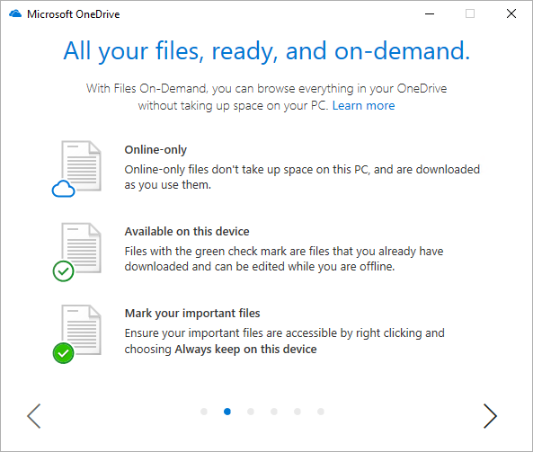
Files On Demand
Requires Windows 10 Version or macOS Mojave
Four Status icons
Online-only – Save space
Available on this device – Cached locally
Mark your important files – Available offline
Syncing – temporary indicator
Works with files and folders
See important information about all files For example: whether they are shared
Thumbnails for over 300 different file types

Slide 9
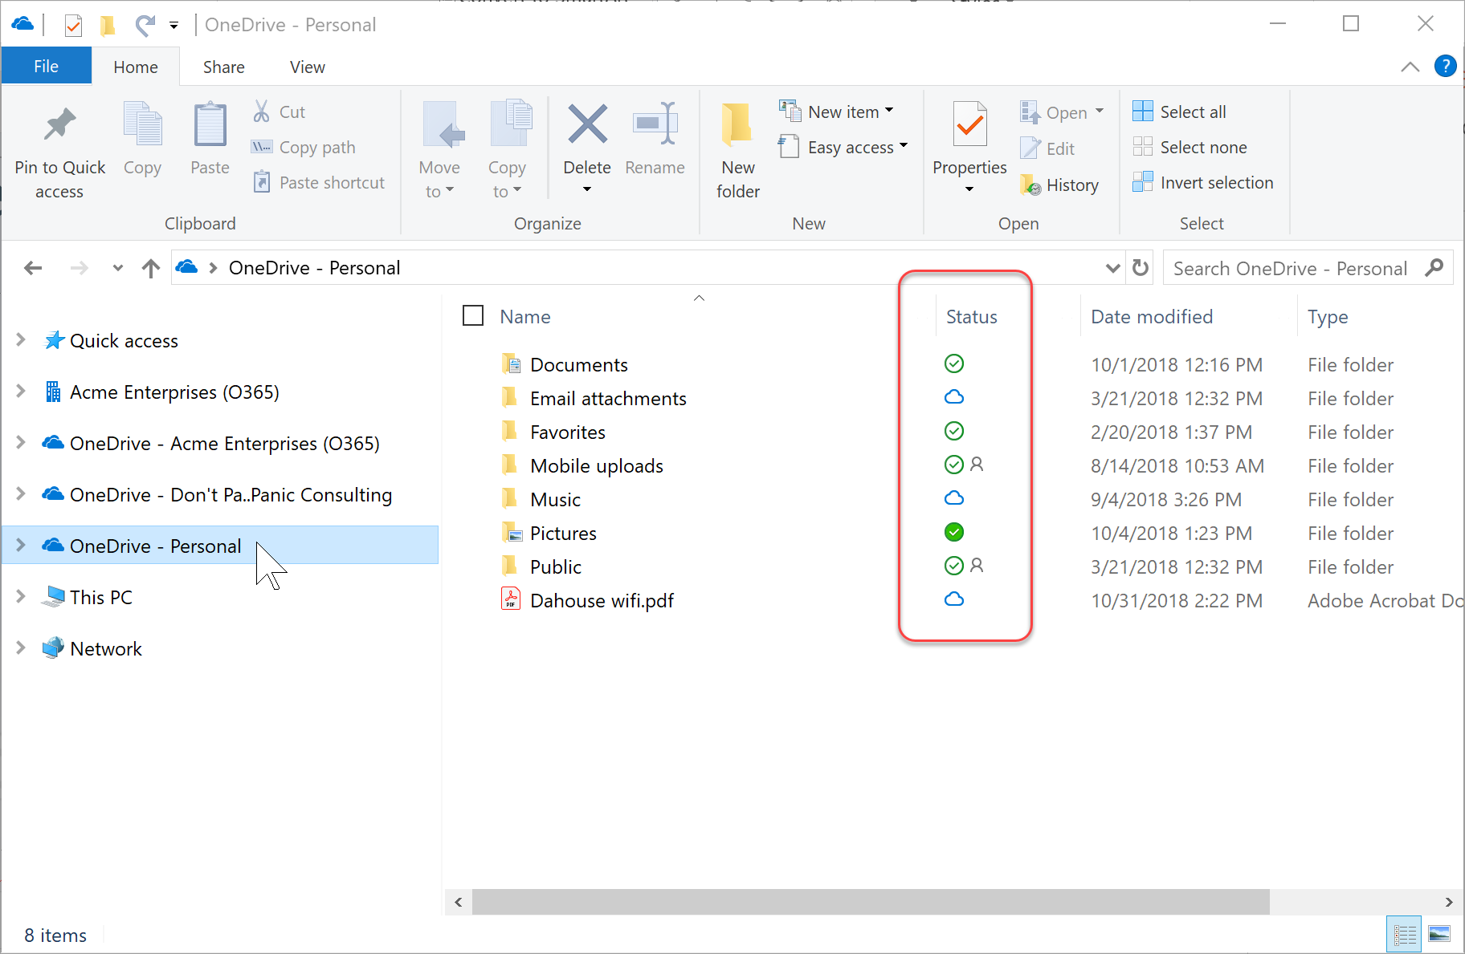
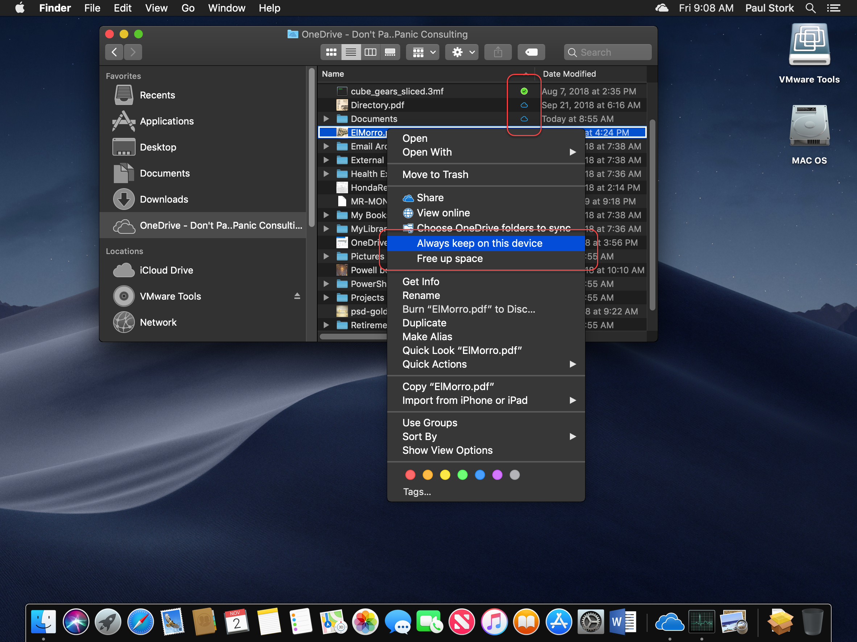
Files On Demand Screenshots

Slide 10
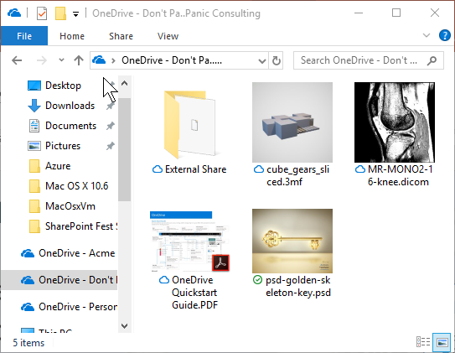
Custom File Viewers
Over 320 different file formats
Documents, Images, Video
3D Objects
Medical Images
No Plug-ins or Third Party Licenses required
More will be added…
Full List available here: http://bit.ly/OD4BFileViewers
Notes:
Here’s the full list of file types that we now support viewing online in OneDrive for Business and SharePoint.
Documents:
csv, doc, docm, docx, dotx, eml, msg, odp, ods, odt, pdf, pot, potm, potx, pps, ppsx, ppt, pptm, pptx, rtf, vsd, vsdx, xls, xlsb, xlsm, xlsx
Images:
ai, arw, bmp, cr2, eps, erf, gif, ico, icon, jpeg, jpg, mrw, nef, orf, pict, png, psd, tif, tiff
Video:
3gp, m4v, mov, mp4, wmv
3D:
3mf, fbx, obj, ply, stl
Medical:
dcm, dcm30, dic, dicm, dicom
Text and code:
abap, ada, adp, ahk, as, as3, asc, ascx, asm, asp, awk, bash, bash_login, bash_logout, bash_profile, bashrc, bat, bib, bsh, build, builder, c, c++, capfile, cc, cfc, cfm, cfml, cl, clj, cls, cmake, cmd, coffee, cpp, cpt, cpy, cs, cshtml, cson, csproj, css, ctp, cxx, d, ddl, di, dif, diff, disco, dml, dtd, dtml, el, emakefile, erb, erl, f, f90, f95, fs, fsi, fsscript, fsx, gemfile, gemspec, gitconfig, go, groovy, gvy, h, h++, haml, handlebars, hbs, hcp, hh, hpp, hrl, hs, htc, hxx, idl, iim, inc, inf, ini, inl, ipp, irbrc, jade, jav, java, js, jsp, jsx, l, less, lhs, lisp, log, lst, ltx, lua, m, make, markdn, markdown, md, mdown, mkdn, ml, mli, mll, mly, mm, mud, nfo, opml, osascript, out, p, pas, patch, php, php2, php3, php4, php5, phtml, pl, plist, pm, pod, pp, profile, properties, ps1, pt, py, pyw, r, rake, rb, rbx, rc, re, readme, reg, rest, resw, resx, rhtml, rjs, rprofile, rpy, rss, rst, rxml, s, sass, scala, scm, sconscript, sconstruct, script, scss, sgml, sh, shtml, sml, sql, sty, tcl, tex, text, textile, tld, tli, tmpl, tpl, txt, vb, vi, vim, wsdl, xhtml, xml, xoml, xsd, xsl, xslt, yaml, yaws, yml, zsh

Slide 11
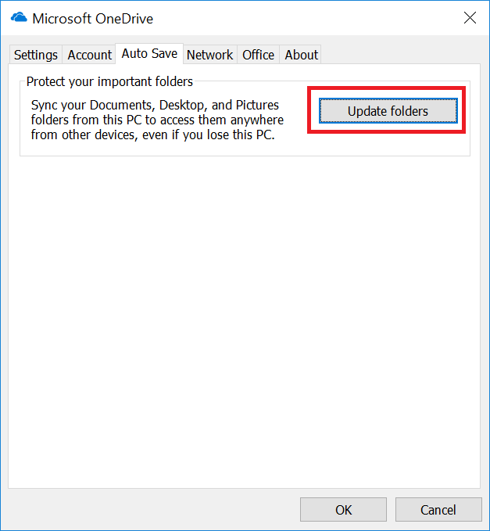
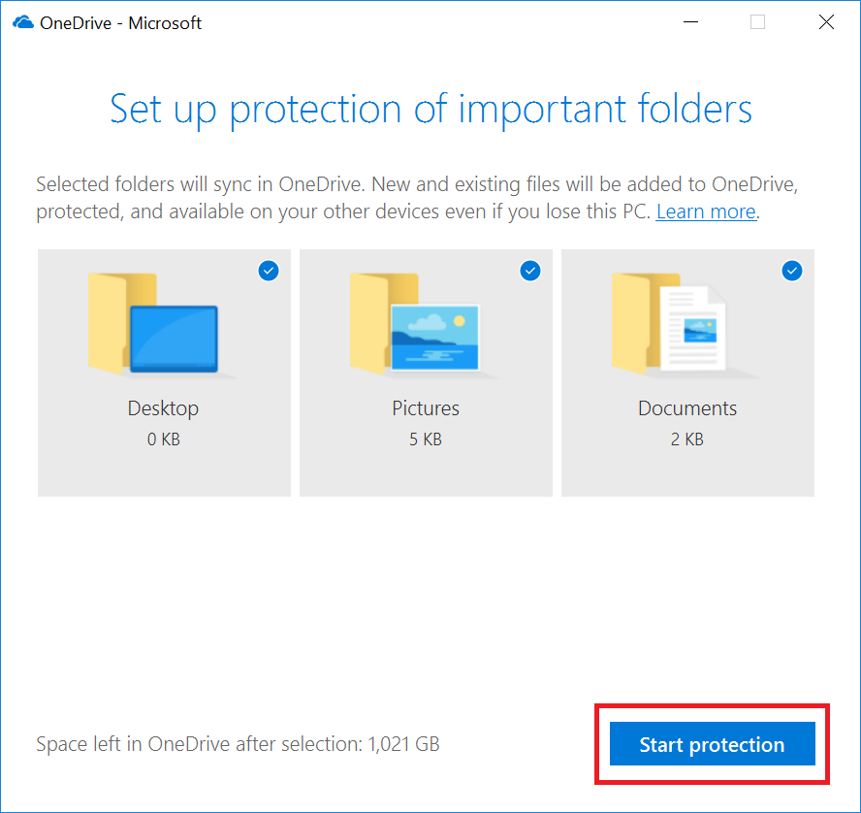
Known Folder Migration (KFM)
Sync 3 common workstation folders
Downloads, Music, & Videos (not supported)
Can be Managed via Group Policy in Domain
Not a replacement for Backup of local machine!

Slide 12
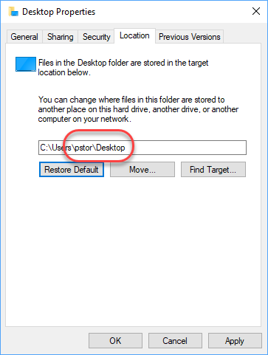
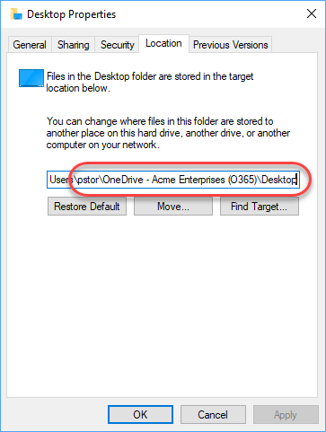
Known Folder Migration (KFM)
BEFORE
AFTER
4 GPO Settings Included:
Prevent users from moving Known Folders
Prevent users from redirecting Known Folders
Silently redirect Known Folders
Prompt users to move Known Folders

Slide 13
Document Management Improvements
Notes:
Files on Demand
Support for Information Rights Management (IRM)
File Viewers for non-Microsoft document formats
Files Restore
Copy/Move Files with Metadata and Versions
Known Folder Move

Slide 14
OneDrive Administration

Slide 15
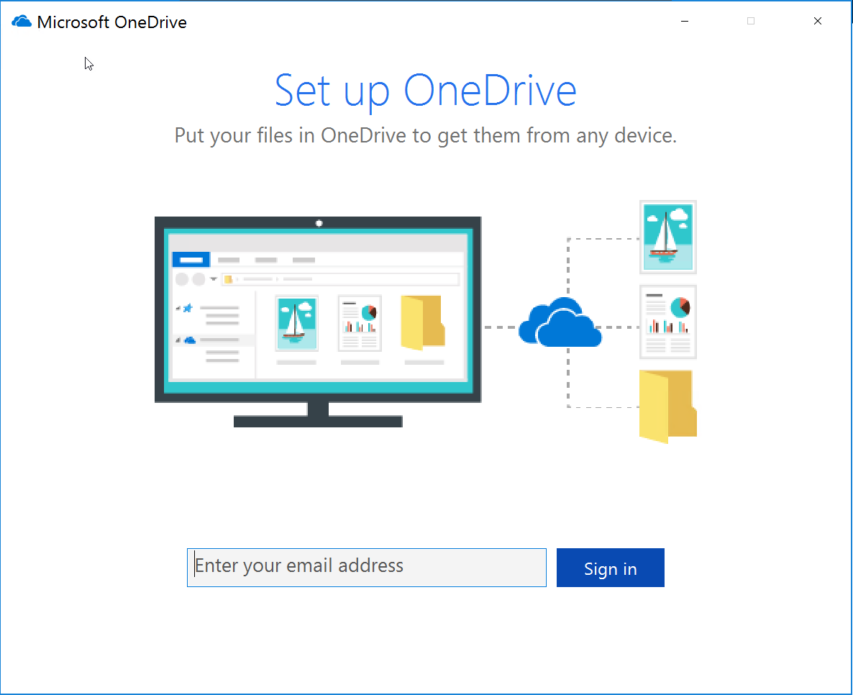
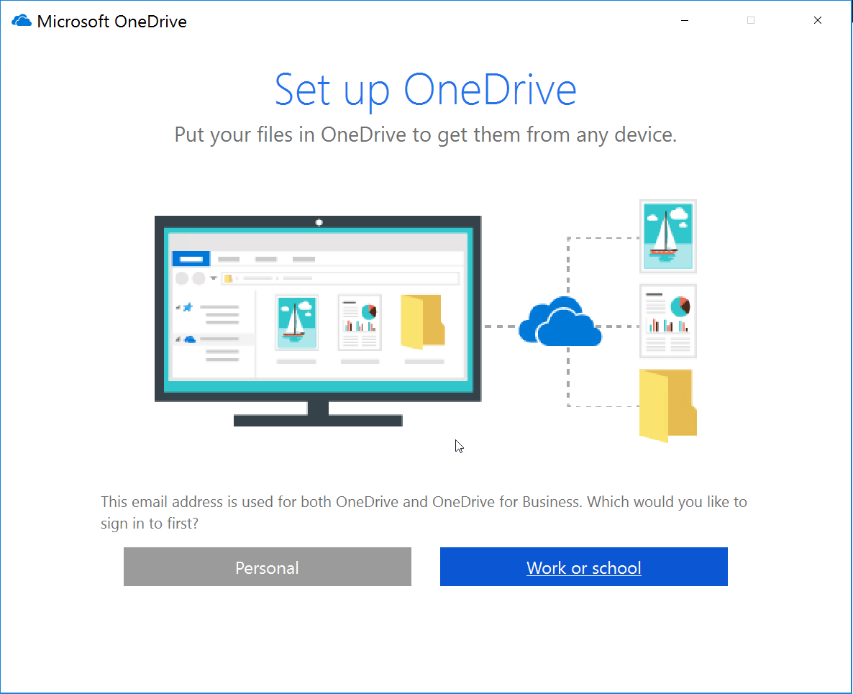
Running the First Time
Enter your email address
Choose
Personal – OneDrive
Work or School – OneDrive for Business

Slide 16
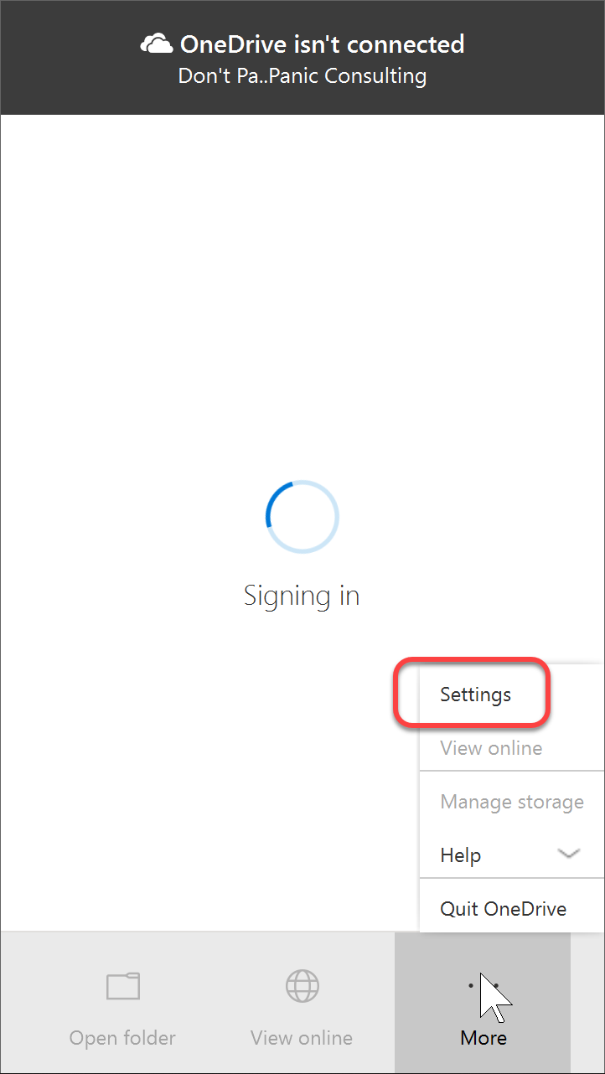
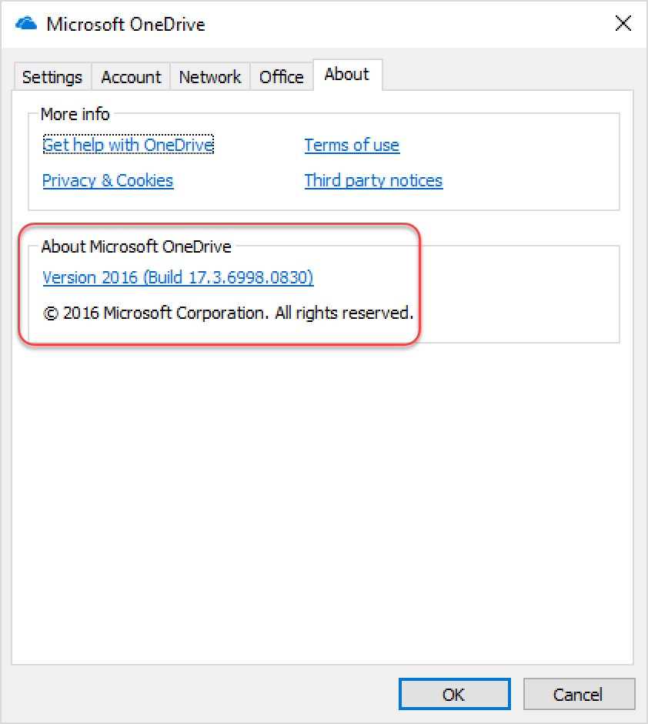
Determining the Version
Use the Context menu to Open Settings
Check the Version # on the About Tab
Clicking the Version link will display release notes

Slide 17
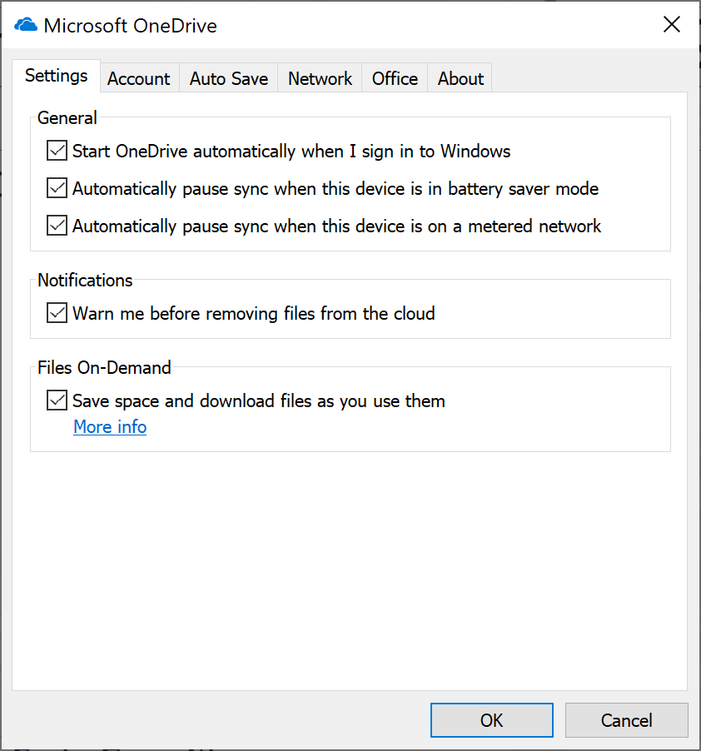
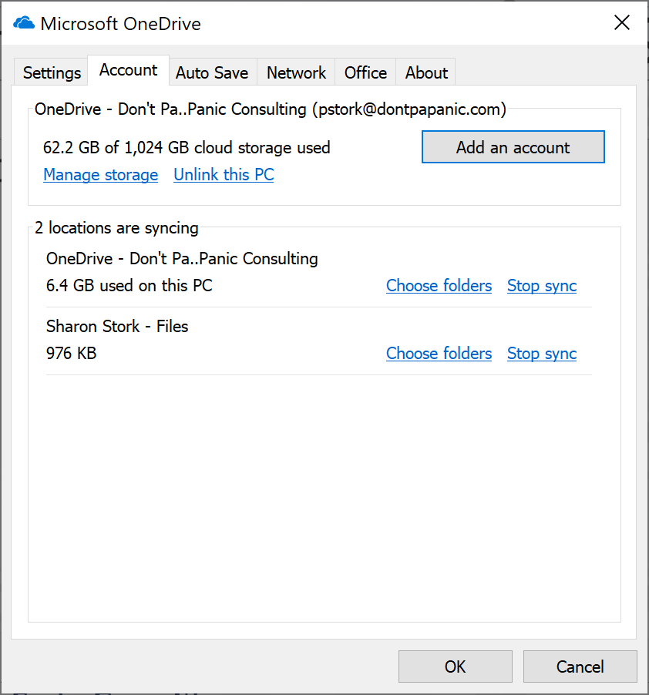
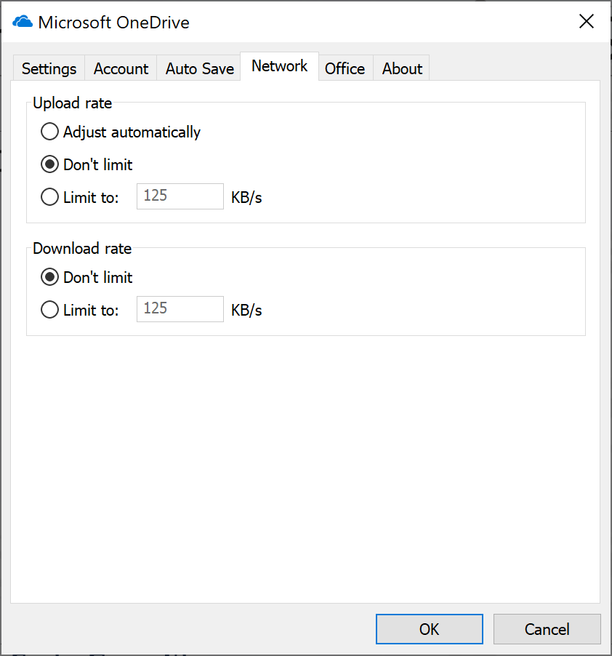
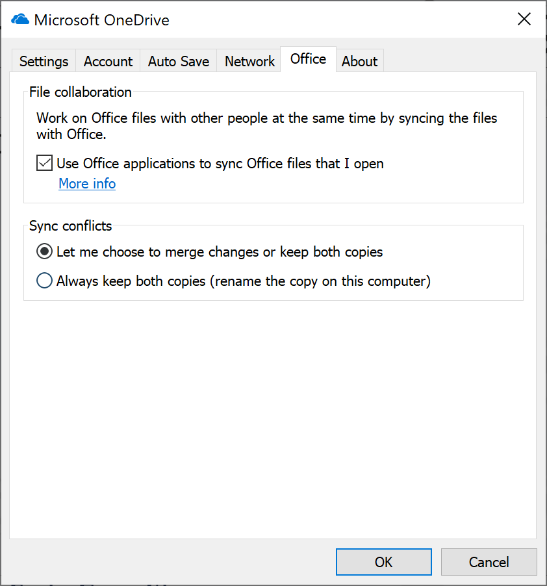
Administer Your OneDrive Sync
Control your OneDrive Sync Client from Settings
Files On-Demand
Add New Accounts
Limit Network Traffic
Control Office Upload

Slide 18
Configuring OneDrive Sync

Slide 19
Installing in the Enterprise
Pre-installed on Windows 10
Support coming for auto provisioning with ADAL
Use System Center Configuration Manager to deploy the new OneDrive sync client
Sample SCCM file - https://go.microsoft.com/fwlink/p/?LinkId=824069
https://support.office.com/en-us/article/Deploy-the-new-OneDrive-sync-client-in-an-enterprise-environment-3f3a511c-30c6-404a-98bf-76f95c519668
Notes:
Microsoft Azure Active Directory Authentication Library (ADAL)

Slide 20
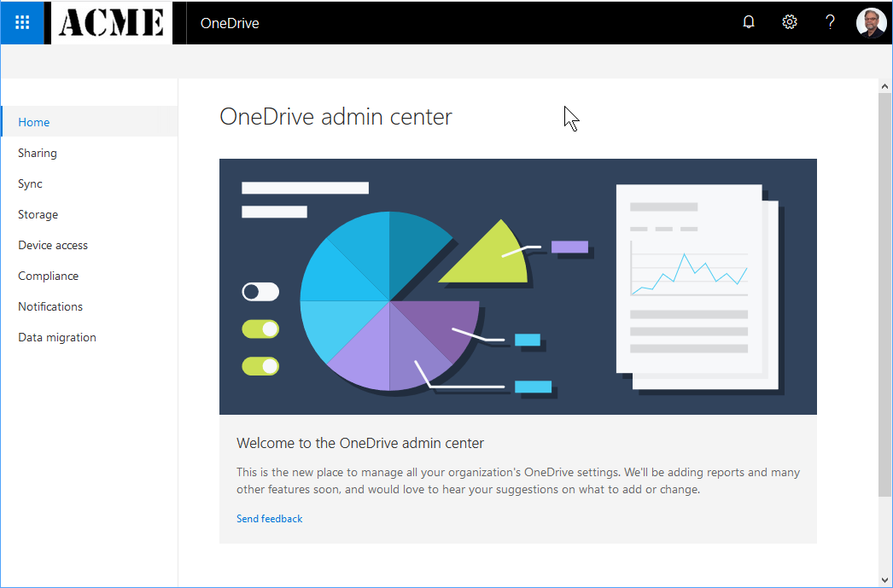
New OneDrive Admin Center
Sync Tab
Globally disable the Sync button
Limit Workstations
Limit File types by extension
Sharing Tab
Default link type
Maximum User Setting
Storage Tab

Slide 21
SharePoint Admin Center
Settings Tab
OneDrive for Business experience – Classic or New
Globally hide the Sync button

Slide 22
Manage using GPOs
Computer Configuration GPO settings:
Block/Allow syncing to specific Tenants
Set the maximum percentage of upload bandwidth that OneDrive uses
Manage Known Folder move
Manage Files-On-Demand
Silent configuration of OneDrive.exe on new clients
User Configuration GPO settings:
Coauthoring and in-app sharing for Office files
Set Default and Prevent users from changing the location of OneDrive folder
Prevent users from configuring personal OneDrive accounts
Let Users choose how to handle Office files in conflict
Delay updating until the second release wave
https://support.office.com/en-us/article/Use-Group-Policy-to-control-OneDrive-sync-client-settings-0ecb2cf5-8882-42b3-a6e9-be6bda30899c

Slide 23
Administering with PowerShell
Get AD Domain GUID
$Domain = Get-ADDomain $DomainGUID = $Domain.ObjectGuid
Restrict Sync to certain domains
Set-SPOTenantSyncClientRestriction -Enable -DomainGuids "GUID; GUID"
Disable Sync on MAC
Set-SPOTenantSyncClientRestriction -Enable -DomainGuids "GUID; GUID" -BlockMacSync:$true
Disable use of Groove.exe Sync Client
Set-SPOTenantSyncClientRestriction -GrooveBlockOption "HardOptIn"

Slide 24
Administering OneDrive Sync

Slide 25
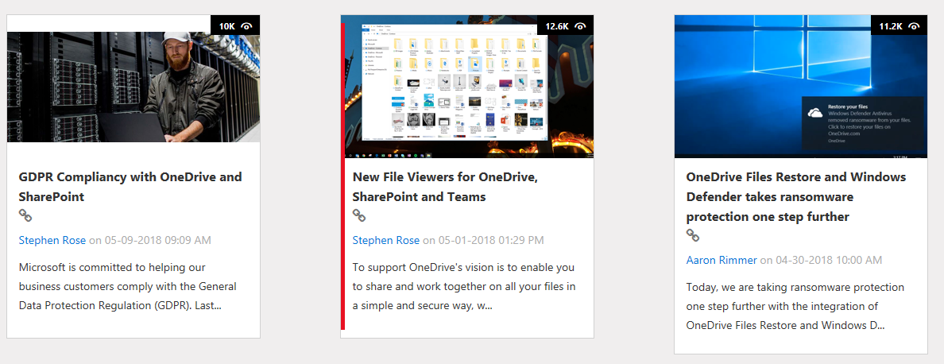
Additional Resources
1
onedrive.com/business
2
techcommunity.microsoft.com/onedrive
3
onedrive.uservoice.com
Don’t Pa..Panic Consulting

Slide 26
Be Sure To Thank Our Sponsors!

Slide 27
JOIN US FOR CAKE AS WE CELEBRATE 10 YEARS OF WOMEN IN SHAREPOINT WITH A “WOMEN IN TECHNOLOGY PANEL” HEADED BY MICRSOSOFT’S CATHY DEW. FRIDAY MARCH 15TH 2:50—3:50 IN TANEYCOMO B BALLROOM
of Women in SharePoint

Slide 28
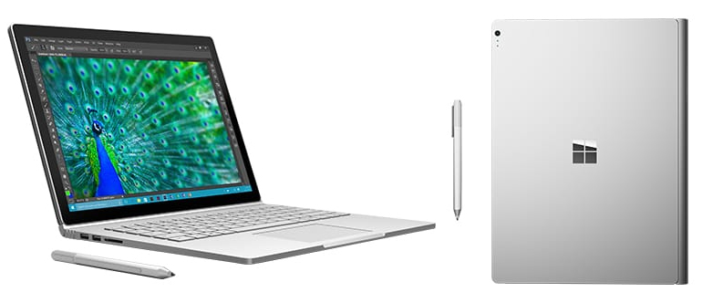
Win a Surface Book courtesy of Microsoft!
Play Vendor Bingo, Winner drawn during closing session on Friday

Slide 29
Questions?
Paul Papanek Stork - MCSM, MVP Owner\Principal Architect Email: pstork@dontpapanic.com Cell: 216.272.0573 Web: https://dontpapanic.com Twitter: @PStork

Slide 30
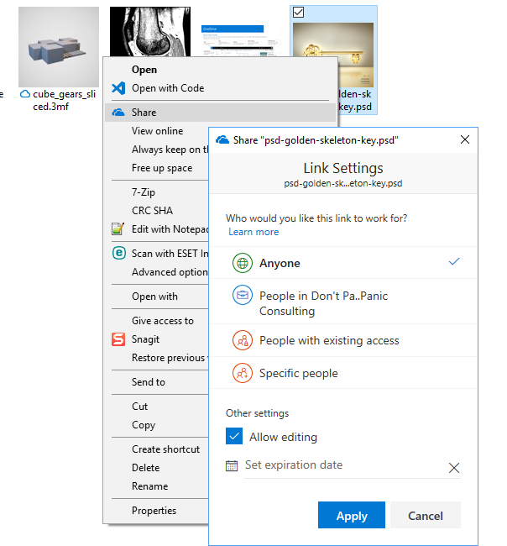
External Sharing Improvements
Unified Sharing Dialogue
Web, PC, Mac, Mobile
Anonymous Link Expiration
Share without a Microsoft Account
Verification code sent to email
Code expires after 15 minutes

Slide 31
Sharing
Receiving
Enhanced sharing and collaboration
@mentions
Comments and notifications for all file types
Comment-only permissions for all file types
Smart people picker w/LinkedIn on mobile: share via Teams
Notify team members on upload
Notifications on comment replies
Activity live updates
Badging for unseen activity
Access
Administration
Expiring access for external users
Password-protected links
Block download
One-click access approval
Manage one-time passcode users as guests
Per-site sharing defaults
Customized access request page
External sharing reports

Slide 32
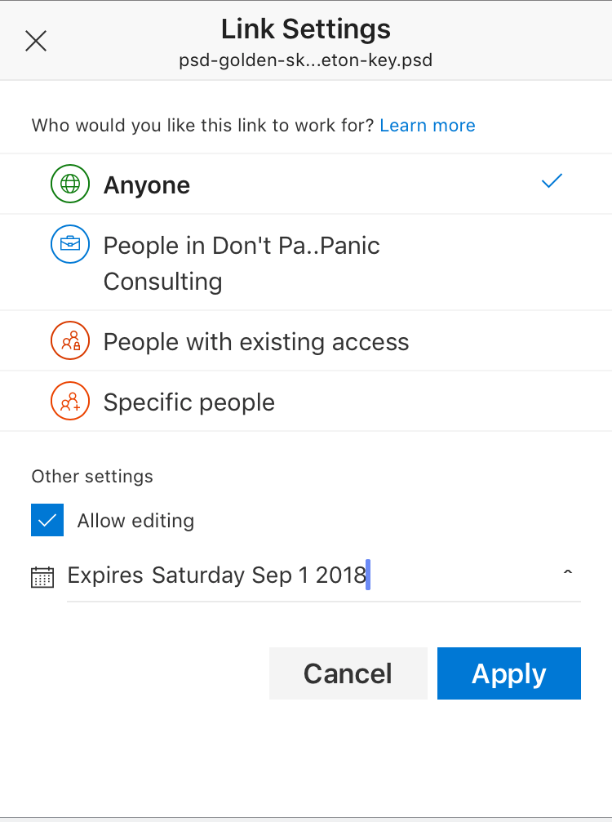
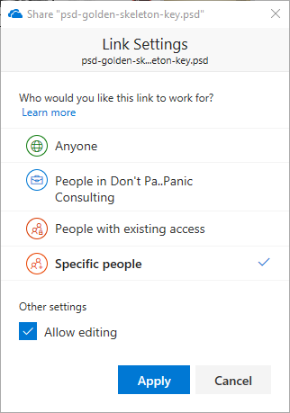
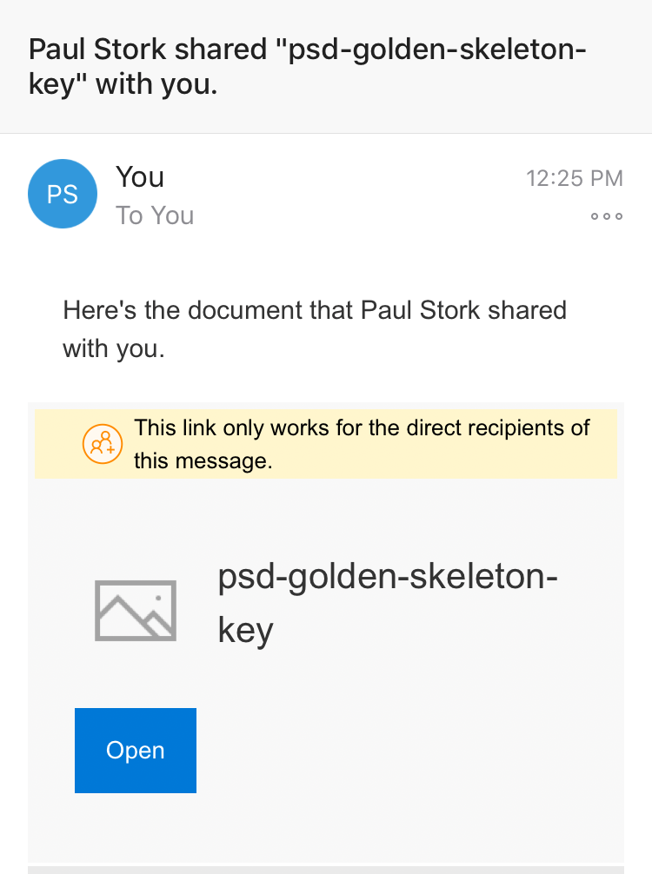
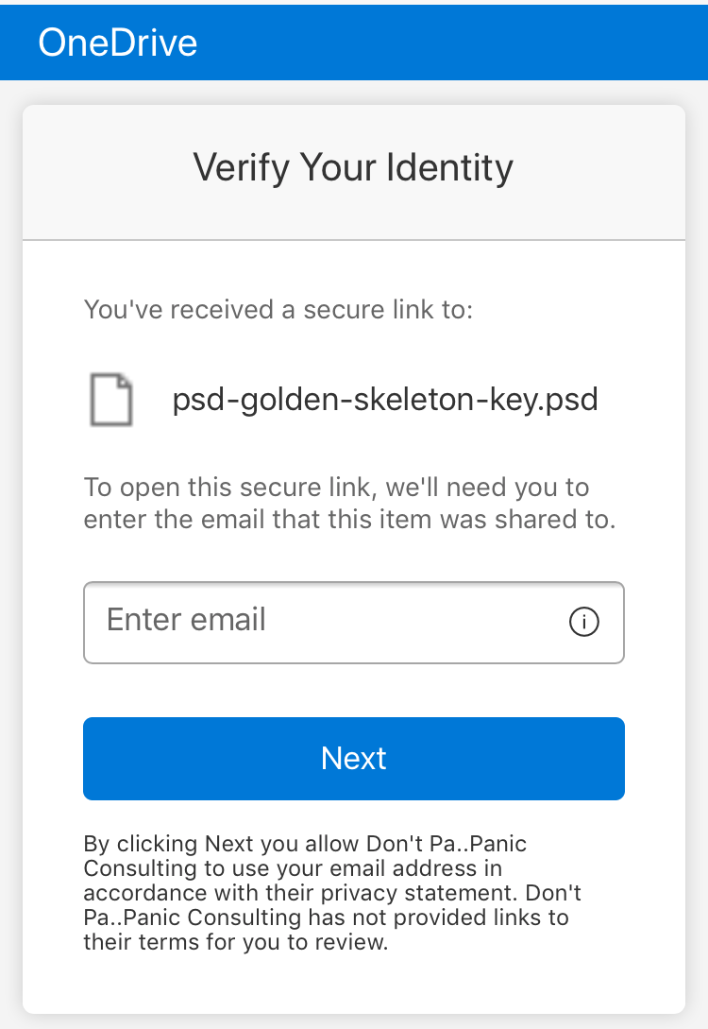
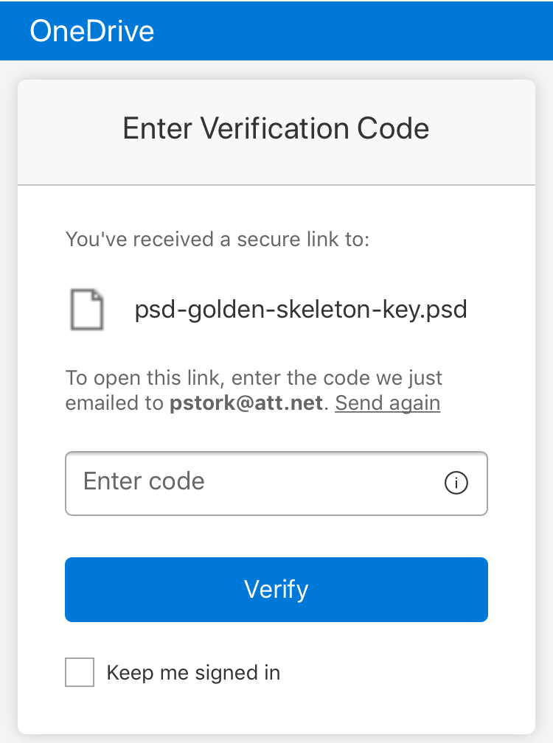
External Sharing Links

Slide 33
Enhanced Mobile Support

Slide 34
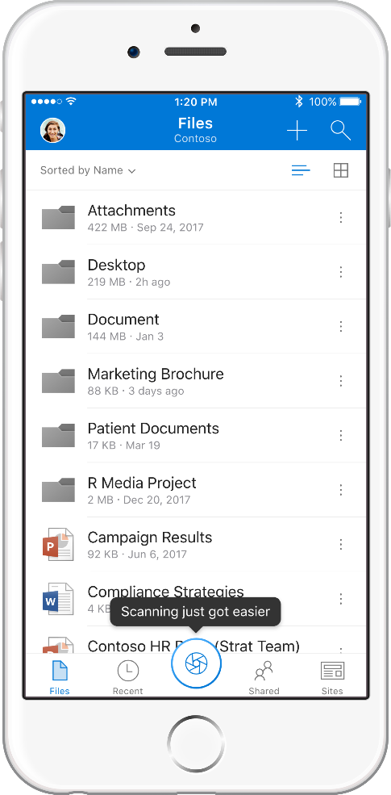
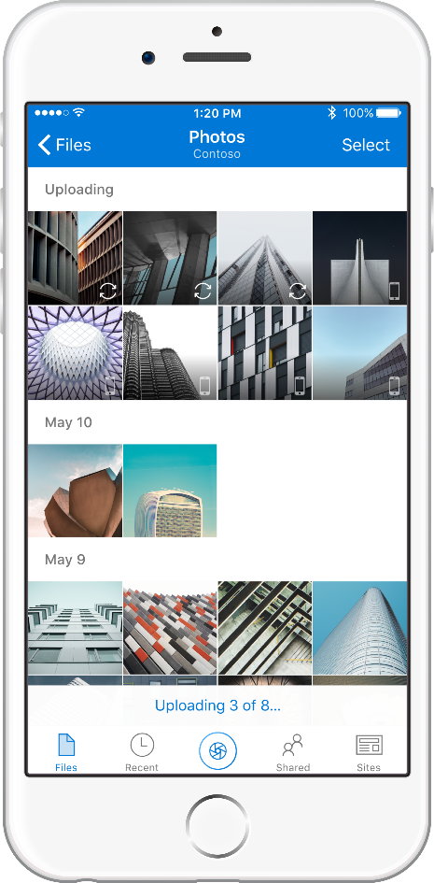
Enhanced Mobile Experience
Automatically Save Photos (OneDrive Consumer Only)
Updated Sharing UX
New Scan Experience
Require Passcode Fingerprint supported
Me Tab – Switch Logins

